Slide 1
Is Hadoop a necessity for data Science ?

Slide 2
AGENDA
Today we will take you through the following:
What is Big Data & Hadoop?
What is a Data Product?
What is Data Science?
Why Hadoop for Data Science?
Is Hadoop a necessity for Data Science?

Slide 3
What is
Big Data & Hadoop?

Slide 4

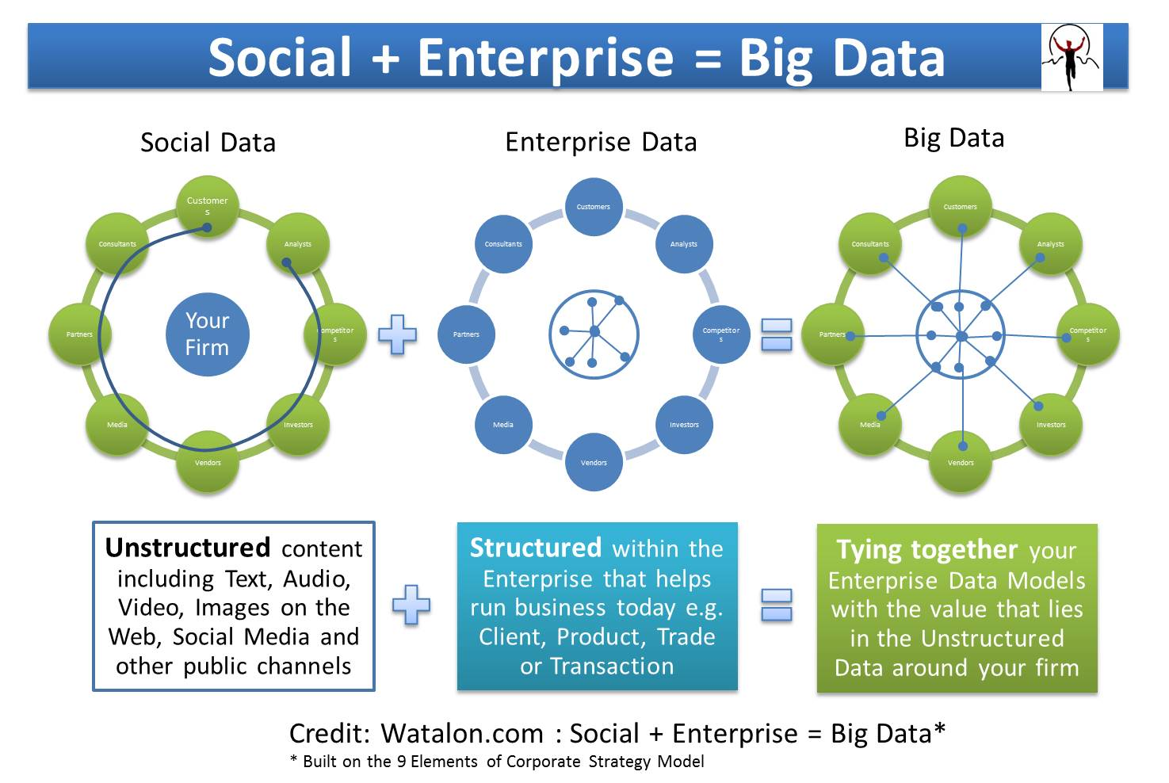
BIG DATA
Big data is a popular term used to describe the exponential growth of data.
Big Data can be either Structured data or Unstructured data or a combination of both.
Big Data

Slide 5
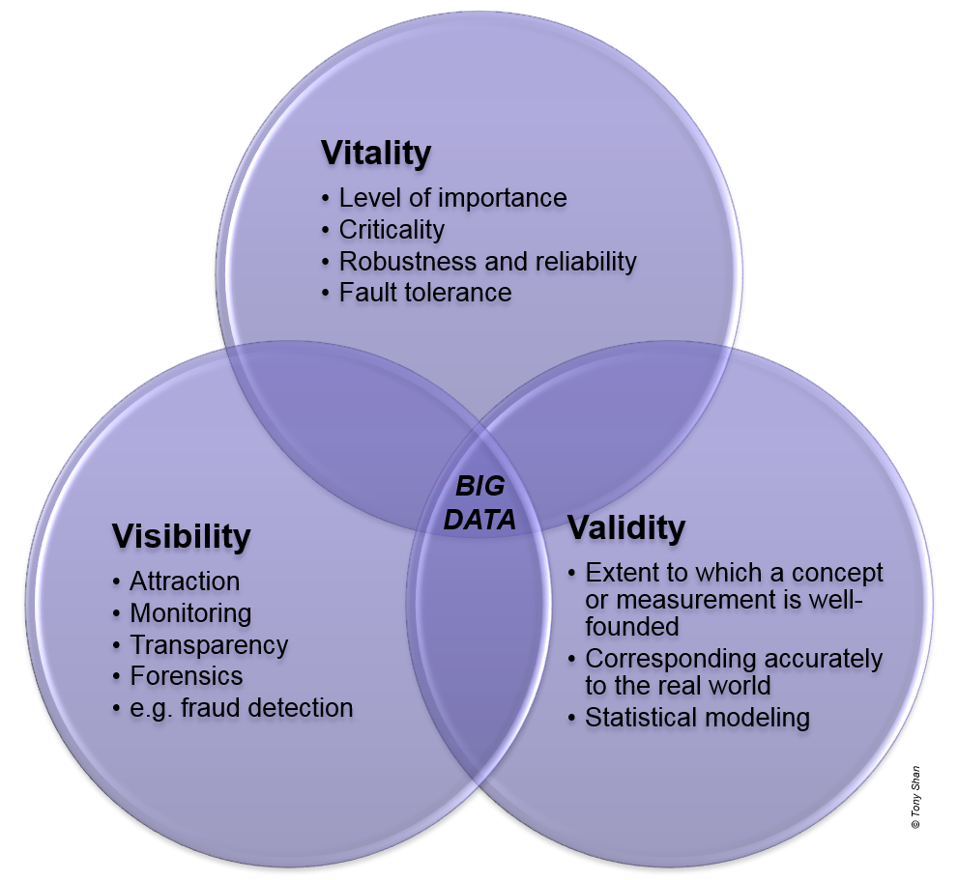
BIG DATA
3 V’s (Volume, Variety and Velocity) are three defining properties or dimensions of Big Data.

Slide 6

HADOOP
Hadoop is a programming framework that supports the processing of large data sets in a distributed computing environment.
Hadoop was the first and still the best tool to handle Big Data.

Slide 7
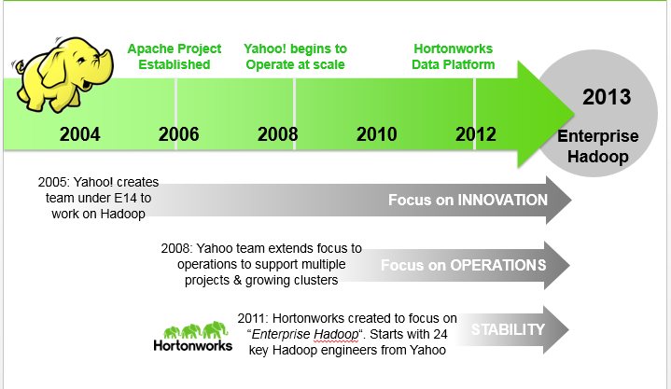
A BRIEF HISTORY OF HADOOP

Slide 8
HADOOP:- HDFS & MAP-REDUCE
Most efficient for Large-Scale Storage & Processing
HDFS: Distributed file system
Self-Healing Data store
MAP-REDUCE: Distributed computation framework that handles the complexities of distributed programming

Slide 9
KEY TO HADOOP’S POWER
Computation co-located with data
Data and computation system co-designed and co-developed to work together
Process data in parallel across thousands of “commodity” hardware nodes
Self-healing; failure handled by software
Designed for one write and multiple reads
There are no random writes
Optimized for minimum seek on hard drives

Slide 10
What is a Data product?
“A software system whose core functionality depends on the application of statistical analysis and machine learning to data.”

Slide 11
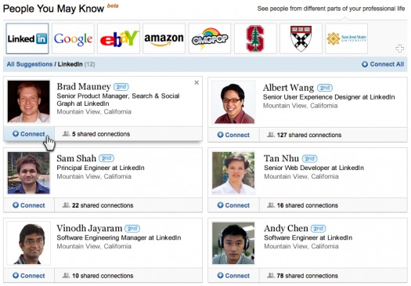
Example #1: People you may know

Slide 12
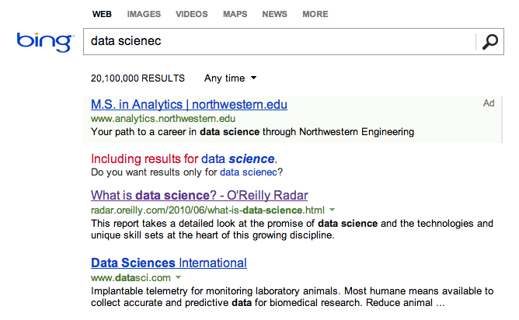
Example #2: Spell Correction

Slide 13
What is
Data Science?

Slide 14
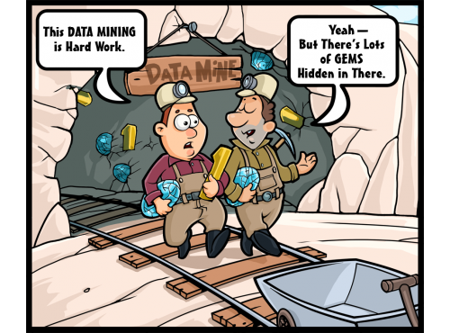
DATA SCIENCE
#1: Extracting deep meaning from data
(data mining; finding “gems” in data)

Slide 15
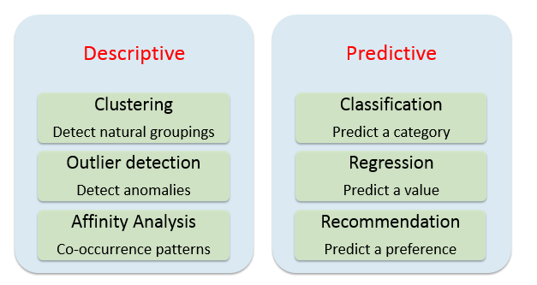
Common Data Science tasks

Slide 16
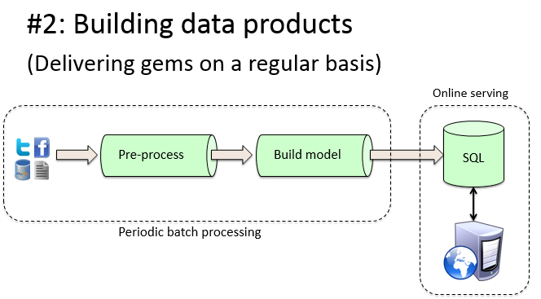
DATA SCIENCE
#2: Building Data Products
(Delivering Gems on a regular basis)

Slide 17
Why HADOOP for DATA SCIENCE?
Reason #1:
Explore full datasets

Slide 18

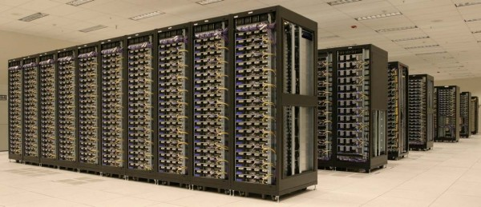
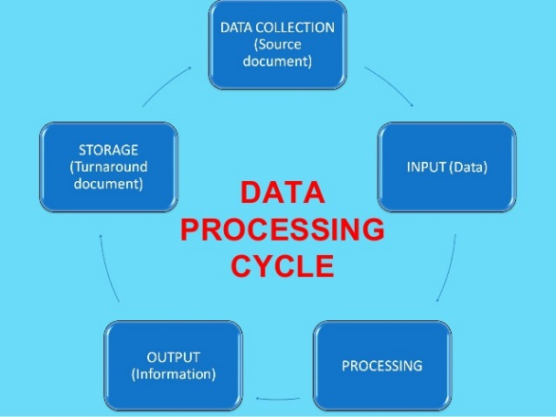
#1: Exploration of Data sets

Slide 19
Why HADOOP for DATA SCIENCE?
Reason #2:
Mining of larger datasets

Slide 20


#2: Mining of larger data sets
More Data ---> Better Outcomes

Slide 21
Why HADOOP for DATA SCIENCE?
Reason #3:
Large-scale data preparation

Slide 22
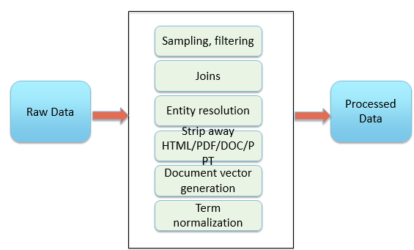
#3: Large-Scale Data preparation
80% of data science work is data preparation

Slide 23
Why HADOOP for DATA SCIENCE?
Reason #4:
Accelerate data-driven innovation

Slide 24
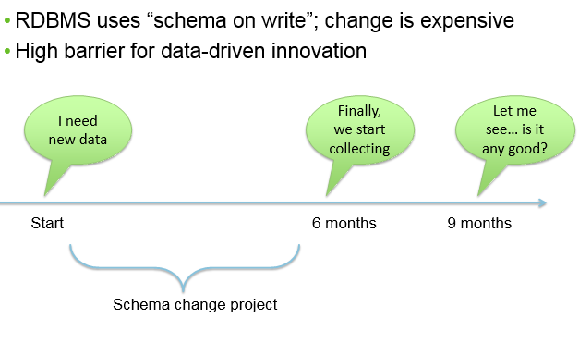
Speed Barriers of traditional Data Architectures

Slide 25
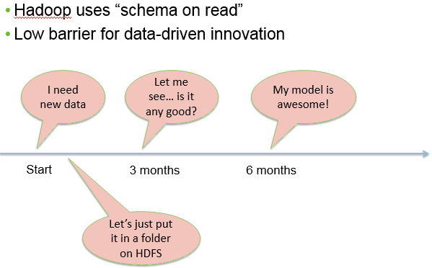
“Schema on read” means faster time-to-innovation

Slide 26
Demo

Slide 28
SURVEY

